Slide 1

Capstone 3: Increasing Movie Revenue and Average Scores
Presented by Samuel Wilson

Slide 2
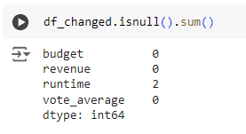
About the Movies Dataset
I pulled the data from Kaggle and used the budget, runtime, revenue, and vote_average columns to test my hypotheses. There were a total of 24 columns of data
There were 4803 unique movies that were recorded in this data set and I found that there were 2 missing values in the runtime column so I opted to omit those 2 movies as it would have a minor impact to the overall analyses

Slide 3
Project Goals
A movie producer is trying to find a way to maximize the likelihood of a higher revenue and a higher average score that will help entice viewers to watch their movie. I came up with the following questions to help guide me through the data set
Does the budget of the movie have an impact on revenue?
Does the budget of the movie have an impact on the average voting score?
Does the runtime of the movie have an impact on revenue?
Does the runtime of the movie have an impact on the average voting score?

Slide 4
Hypotheses
Null Hypothesis: A higher budget does not change the movie’s revenue.
Alternative Hypothesis: A higher budget indicates that the movie will have a higher revenue.
-----------------------------------------------------------------------------------
Null Hypothesis: A higher budget does not change the movie’s average voting score.
Alternative Hypothesis: A higher budget indicates that the movie will have a higher average voting score.
-----------------------------------------------------------------------------------
Null Hypothesis: A higher runtime does not change the movie’s revenue.
Alternative Hypothesis: A higher runtime decreases the movie’s revenue.
-----------------------------------------------------------------------------------
Null Hypothesis: A higher runtime does not change the movie’s average voting score.
Alternative Hypothesis: A higher runtime indicates that the movie’s average voting score will be lower.

Slide 5
Process
Find a dataset with a large selection of movies that includes budget, runtime, revenue, and average score when polling viewers.
Drop the data from the dataset that I will not be using to increase usability and clean null values as needed.
Conduct statistical analyses to see if there is any statistically significant impacts that would support the hypotheses.
Create visualizations to show a correlation between budget and runtime to revenue and average score

Slide 6
How will the findings be used?
A film producer will be interested in knowing:
Does the budget impact how much money the movie will make or how well rated it will be?
Does the runtime have an impact on how much the movie will make or how well rated it will be?
Knowing these things will be helpful in being able to target a higher revenue and a higher rating.

Slide 7
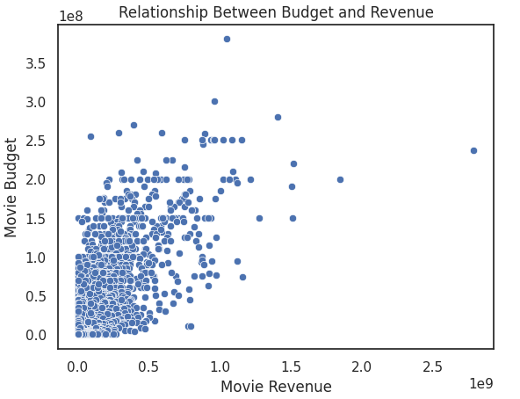
Relationship between Budget and Revenue
When running a correlation test, the data showed that there is a strong positive correlation (0.73) between budget and revenue. The p-value being close to zero suggests that this correlation is statistically significant. This indicated that the correlation is not likely due to random chance.

Slide 8
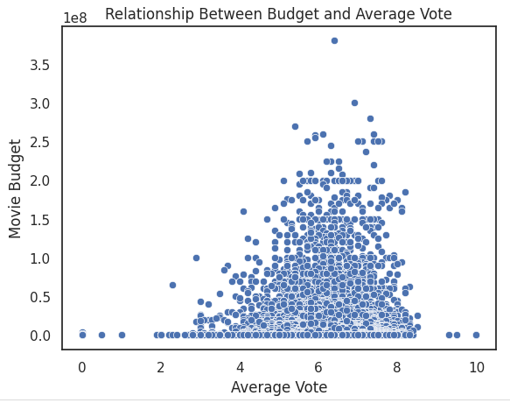
Relationship between Budget and Average Score
When running a correlation test, the data showed that there is a weak positive correlation (0.09) between budget and average score. The p-value being close to zero suggests that this correlation is statistically significant. This indicated that the correlation is not likely due to random chance.

Slide 9
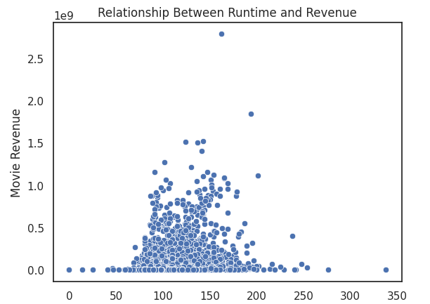
Relationship between Runtime and Revenue
When running a correlation test, the data showed that there is a moderate positive correlation (0.25) between runtime and revenue. The p-value being close to zero suggests that this correlation is statistically significant. This indicated that the correlation is not likely due to random chance.

Slide 10
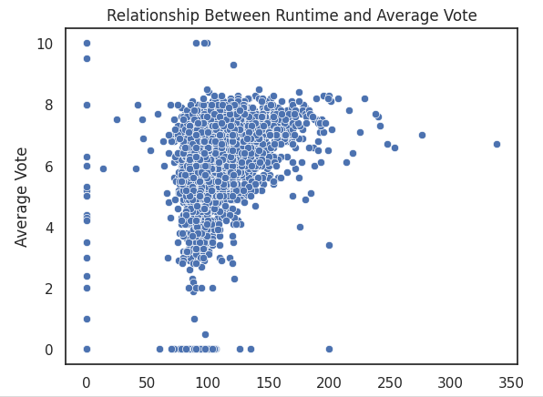
Relationship between Runtime and Average Score
When running a correlation test, the data showed that there is a strong positive correlation (0.375) between runtime and average score. The p-value being close to zero suggests that this correlation is statistically significant. This indicated that the correlation is not likely due to random chance.

Slide 11
Project Summary
These hypotheses were supported by my findings here:
A higher budget indicates that the movie will have a higher revenue. This was shown to have a strong correlation that is unlikely due to random chance.
A higher budget indicates that the movie will have a higher average voting score. This was shown to have a weak correlation, but still positive and this was also unlikely due to random chance.
These hypotheses were not supported by my findings here
A higher runtime decreases the movie’s revenue. The analyses showed that there was a moderate positive correlation showing that a higher runtime is likely to increase revenue and that this is not due to random chance.
A higher runtime indicates that the movie’s average voting score will be lower. The analyses showed that there was a strong positive correlation showing that a higher runtime is likely to increase the average vote and that this is not due to random chance.

Slide 12
Recommendations
Increase budget to be able to increase the revenue that you can earn.
Increase the movie's runtime to be able to increase both revenue and the average score by voters.
Project Proposal
Colab Notebook

